Slide 1

Power BI Business Intelligence for everyone

Slide 2

Power BI : Agenda
Overview
How to acquire
Power BI Report Server for the BI user
Power BI Report Server for the IT Pro
Scenarios
Summary

Slide 3
What is Power BI ?
What is Power BI ?
Microsoft Power BI is a Self – Service business intelligence cloud service that provides business users for analysing , Visualizing and sharing the data.
Power BI Components :
Power BI Desktop
Power BI Service
2.1 Power BI Pro
2.2 Power BI Premium
Power BI Mobile
Power BI Desktop Features and Limitations

Slide 4
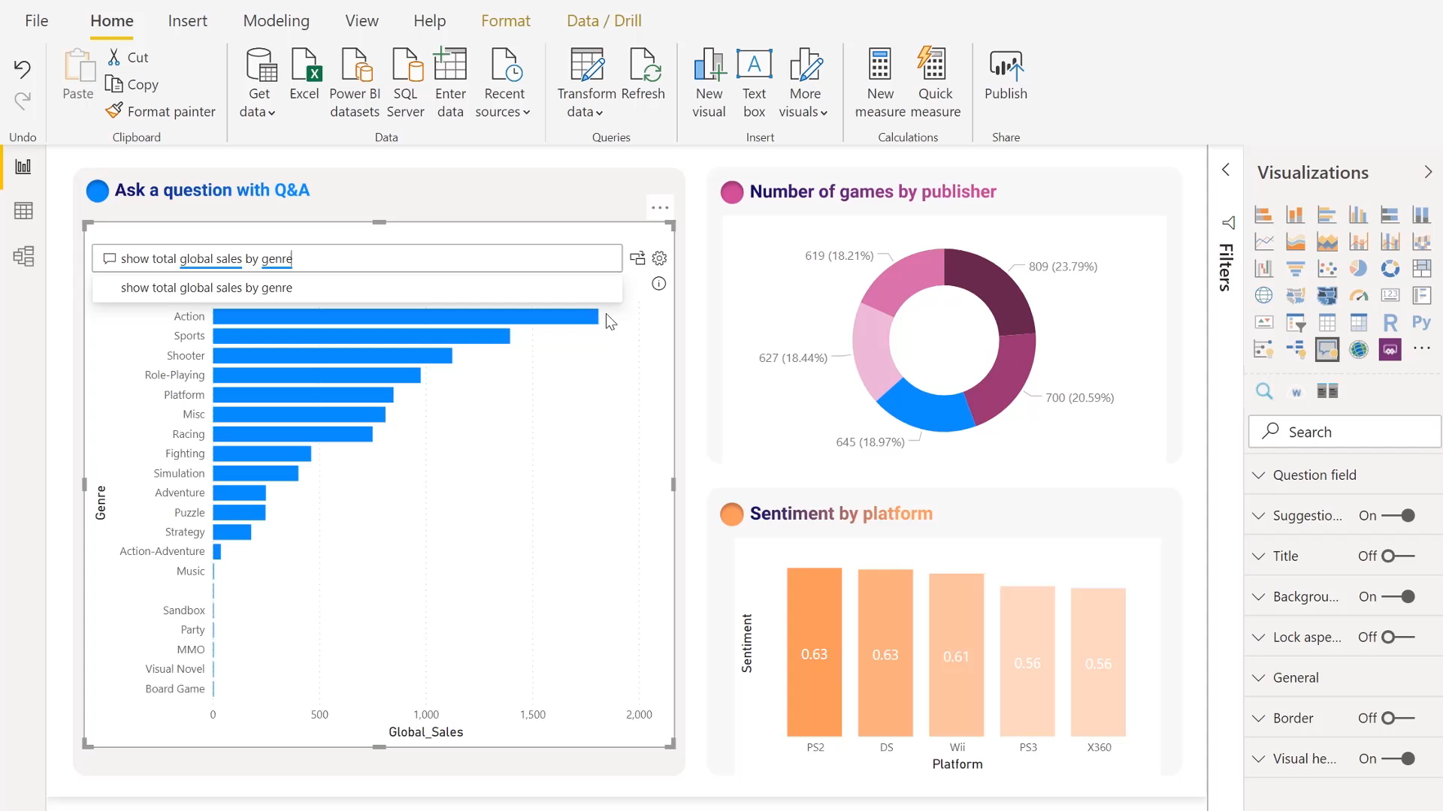
Data made visual
Power BI : Bridge the gap b/w Data and Decision making
Notes:
Create amazing data experiences
Easily connect to, model, and visualize your data, creating memorable reports personalized with your KPIs and brand. Get fast, AI-powered answers to your business questions—even when asking with conversational language.

Slide 5
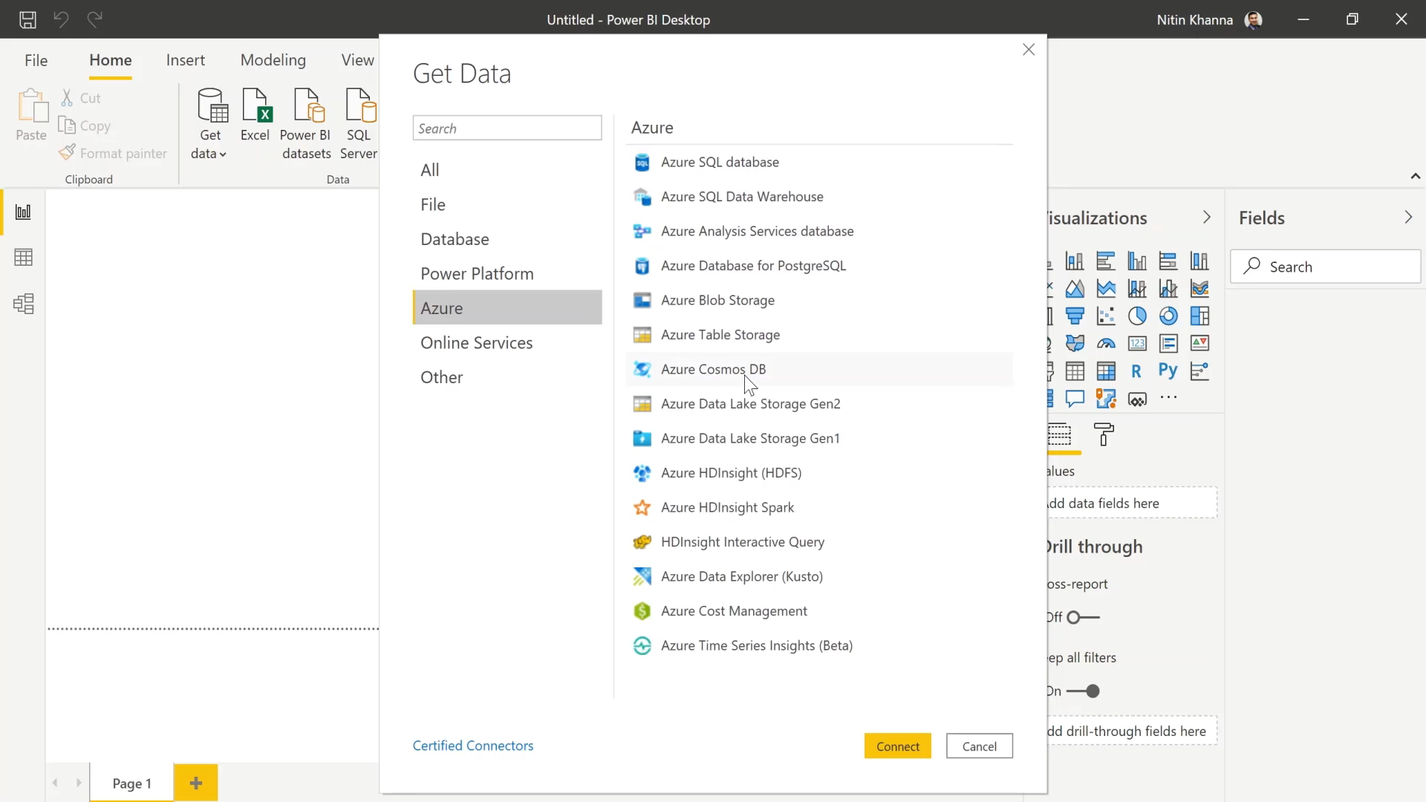
Insights at scale
Power BI : Bridge the gap b/w Data and Decision making
Notes:
Gain insight from your largest BI deployments
Make the most of your big data investments by connecting to all your data sources with the scale to analyze, share, and promote insights across your organization while maintaining data accuracy, consistency, and security.

Slide 6
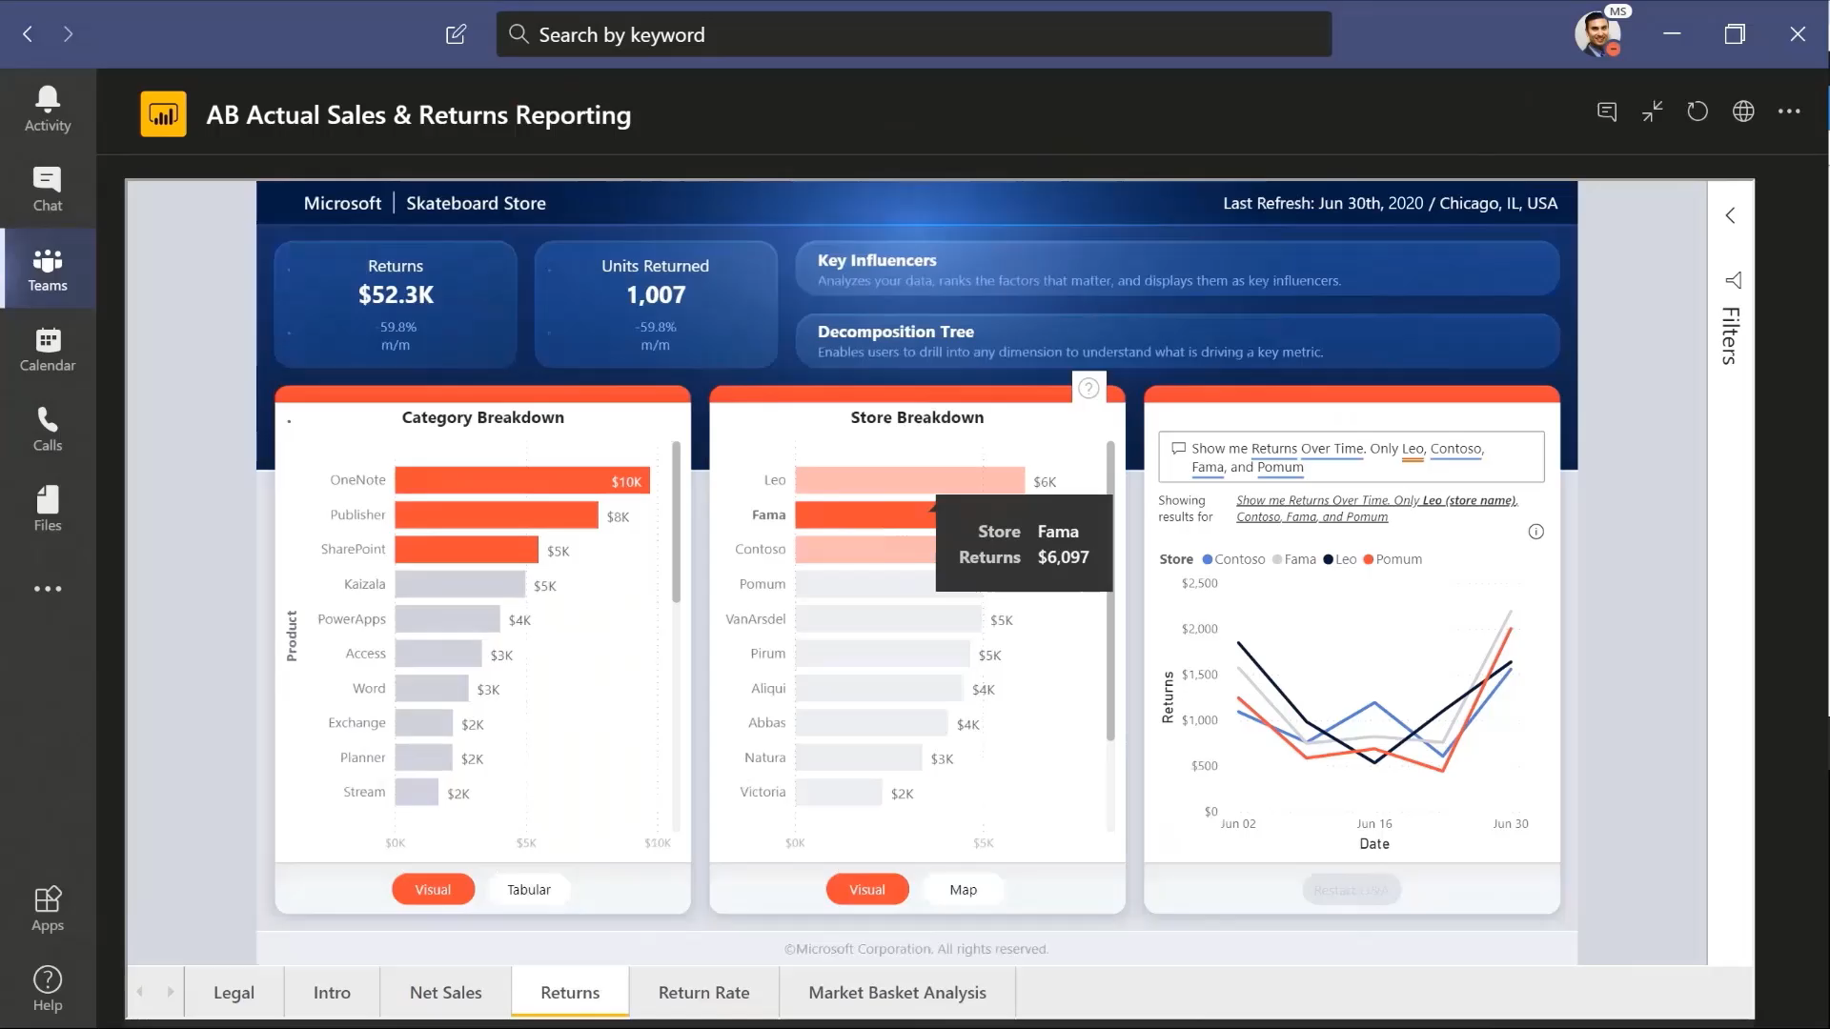
Strategic, actionable decisions
Power BI : Bridge the gap b/w Data and Decision making
Notes:
Make decisions with confidence
Work together easily on the same data, collaborate on reports, and share insights across popular Microsoft Office applications such as Microsoft Teams and Excel—empowering everyone in your organization to quickly make data-driven decisions that drive strategic actions

Slide 7
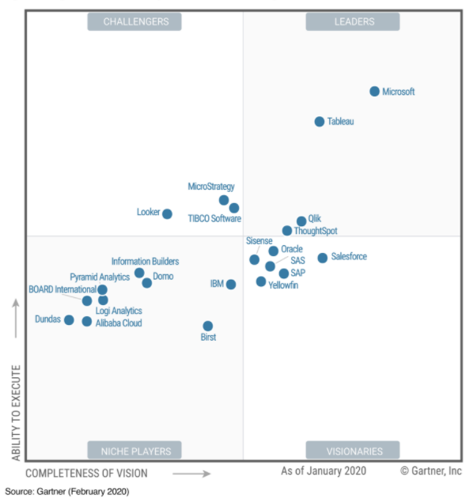
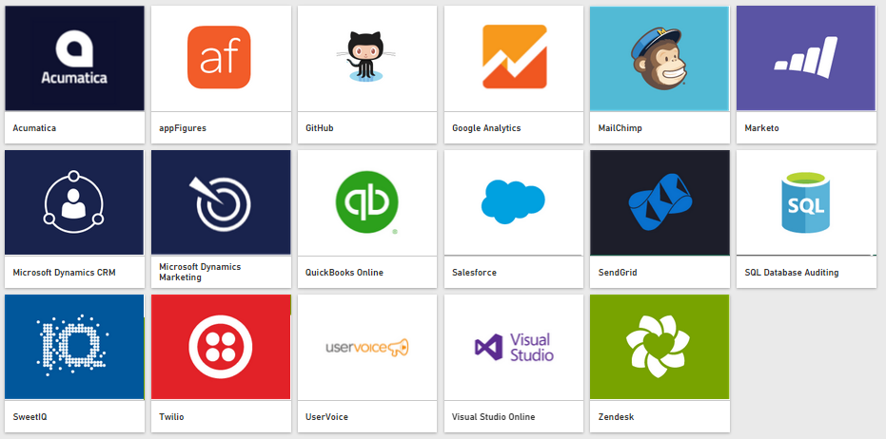
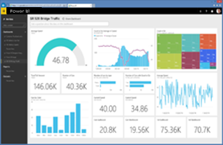
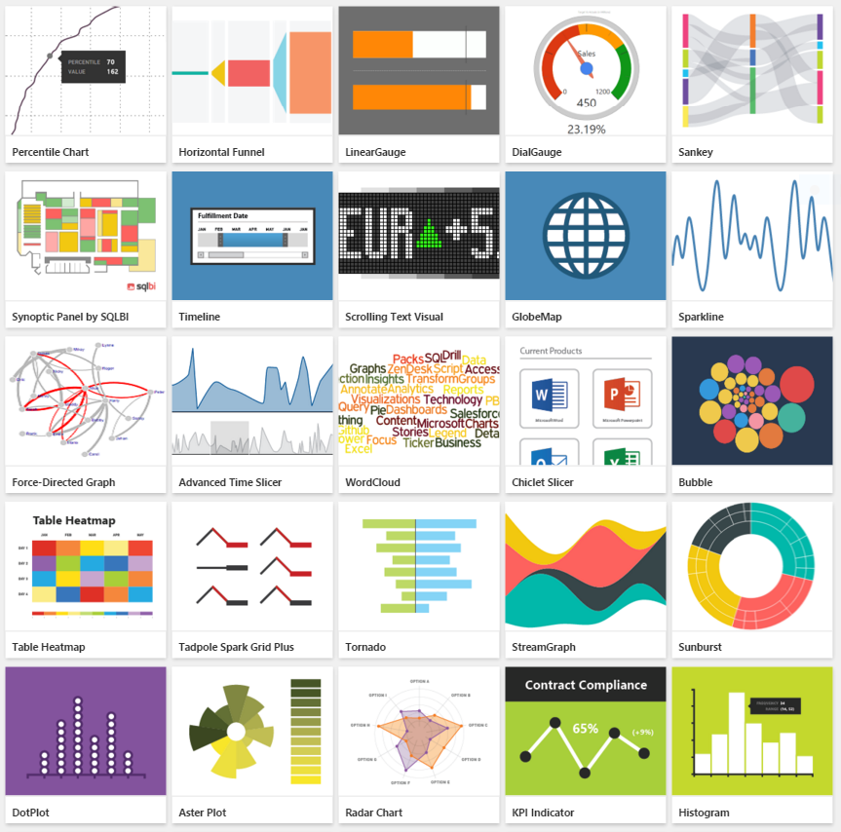

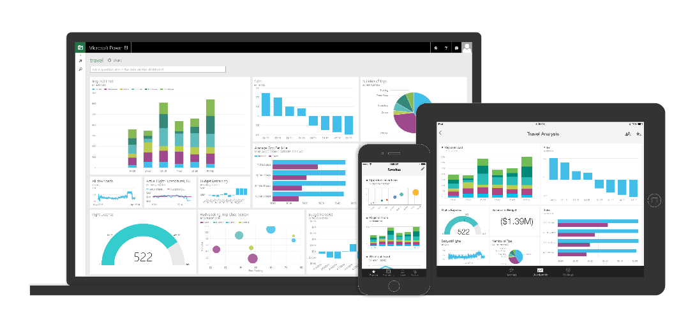










What is Power BI ?
Industry leader in
business intelligence
Bring your data together in new ways, wherever it is, yourself
Live 360º view of your business
Unmatched user experience
Natively integrated with apps + services that matter to you
Industry leader
Begin visualizing your data in minutes, yourself
See your data update in real time
You choose how to experience your data
Platform for BI integrating with Office, Azure, and third-party
Data Warehouse
Internet of Things
Big Data
Advanced Analytics
Connect live to your on-premises data
The above quotes were published by Gartner, Inc. as part of a larger research document and should be evaluated in the context of the entire document. Reprints of the documents are available upon request from Microsoft. Gartner does not endorse any vendor, product or service depicted in its research publications, and do not advise technology users to select only those vendors with the highest ratings or other designation. Gartner research publications consist of the opinions of Gartner’s research organization and should not be construed as statements of fact. Gartner disclaim all warranties, expressed or implied, with respect to this research, including any warranties of merchantability or fitness for a particular purpose

Slide 8
Power BI: experience your data Any data, any way, anywhere
Power BI : Overview
Experience your data _{Any data, any way, anywhere}
DATA
ACTIONS
INSIGHTS
Power BI reports
Get started quickly
People
Cloud
Live Dashboards
Natural Language Query
Custom Visualizations
Apps
On-premises
Power BI
Automation
PC
Mobile
HoloLens
Notes:
So when we think of Power BI we think of a comprehensive solution for BI and reporting and analytics.
It can connect to your data wherever it exists out of the box. So even though Power BI is a service that was born in the cloud, its not limited to only connecting to data source in the cloud. So whether your data is in the cloud or on-premises, Power BI can connect to it. And it doesn’t take a lot of complicated configuration.
So Power BI supports hybrid connectivity using the On-premises Data Gateway, which is a little utility that you install within your data center that has line of site to your on-premises data sources.
The Data Gateway supports secure access to your data sources on-premises without you have to open up ports or do anything like that.
There’s a personal version of the Data Gateway that’s intended to be installed on your desktop and there’s an Enterprise version that you install on a server and can be scaled out to support high availability.
And once your data is in Power BI, you can create reports using Power BI Desktop and publish those reports to the Power BI Service.
And in the service you can create Power BI specific dashboards, which contain visualizations from many reports to use that as your high-level starting point to get a pulse on your organization’s business.
Not only that, you can also stream live data directly into your dashboard for real-time reporting capabilities.
In your dashboards, and in the mobile apps now, you can also leverage the Natural Query Language, which allows you to ask questions in your own natural language (English or Spanish).
Also, one of the really cool thing about Power BI is that the visualization stack is open.
This is just a brief overview of the features and capabilities that you have in Power BI.
You can view your Power BI content in your web browser, mobile apps, or embedded in your custom applications.

Slide 9
Power BI: extending on-premises capabilities
Power BI : Overview
Extending on-premises capabilities
Power BI reports
Power BI reports
SSRS reports
Get started quickly
Custom
Visualizations
Live Dashboards
Natural Language Query
Custom Visualizations
Power BI Report Server
Power BI
Notes:
When Power BI was first released, only cloud data sources were supported.
But Microsoft was one of the first in the industry to innovate a method for being able to reach on-premises data sources using the On-premises Data Gateway to offer this hybrid type of functionality.
Many customers are using this type of setup today.
But we still have some customers that for whatever reason, due to laws and regulations, company policies, or simply personal preferences, but they have to keep their reporting solution on-premises.
Microsoft has always been about giving our customers that choice: run in the cloud or run on premises.
Your Power BI reports can be deployed to the Power BI Service running in the cloud or you can deploy your Power BI reports on-premises in Power BI Report Server. It’s totally up to the customer.
Power BI Report Server allows you to store and run your reports on-premises, and because its on-premises, you don’t need to install and set up the On-premises Data Gateway.
Power BI Report Server is built on SQL Server Reporting Services, so that means its compatible with SSRS. Power BI Report Server includes a superset of the features of SSRS. This means that Power BI RS can do everything SSRS can do, plus host interactive Power BI Reports. This also means that your existing SSRS reports can be easily migrated to Power BI Report Server with very little work.

Slide 10



Power BI : Overview
Power BI Report Server Self – service BI and enterprise reporting in one solution
Keep Power BI reports on-premises
Power BI reports
SSRS reports
Compatible with SSRS
Custom
Visualizations
Move to the cloud on your terms
Power BI Report Server
Notes:
Keep your Power BI reports on-premises.
PBI RS is compatible with SSRS because it is SSRS.
In terms of the Power BI reports you develop, those reports are compatible with the Power BI Service in the cloud meaning that you can effectively migrate those reports to the cloud on your terms whenever you’re ready.
So if you’re building a report in Power BI Desktop, you can publish that report to Power BI Report Server and then later publish the report to the Power BI Service.
This is great news for our customers that have to keep their data and reports on-premises, but have a roadmap where they can see being able to deploy to the cloud. Power BI Report Server sets these types of customers up to be able to quickly scale out and take advantage of cloud resources.

Slide 11
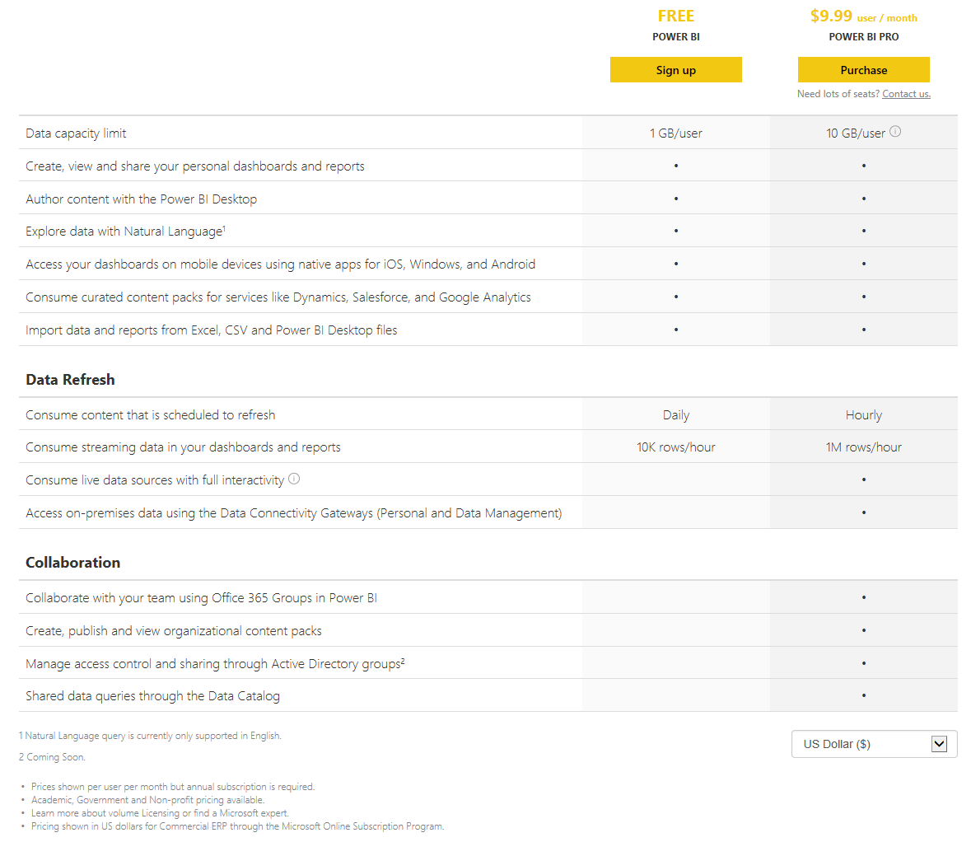
Power BI Pricing details

Slide 12
Power BI Desktop Features and Limitation comparability matrix
Feature | Multi-Dimensional (Import Mode) | Multi-Dimensional (Live Mode) | Relational Database (Import Mode) | Relational Database (Live Mode) | Tabular model (Import Mode) | Tabular model (Live Mode)
Measure Creation | Yes | No | Yes | Limited DAX Compatibility¹ | Yes | Yes
Large Datasets | No | Yes | No | Yes | No | Yes
Small Datasets | Yes | Yes | Yes | Yes | Yes | Yes
Maximum Dataset Size | 1 GB² | Server Resource Limits³ | 1 GB | Server Resource Limits | 1 GB | Server Resource Limits
IT Governance | Poor | Good | Poor | Poor | Poor | Good
Data Governance | Poor |  | Poor | Poor | Poor | Good
Full Multi - Dimensional Support | No | No⁴ | NA | NA | NA | NA
Full Tabular Feature support | NA | NA | NA | NA | No | Yes
Multiple Data sources | Import Only | No | Import Only | Import/Live (Relational Databases only) | Import only | No (Multiple Data sources can be used to create the tabular model
Ease of use | Poor | Good | Good | Good | Poor | Good
Model Maintenance | Poor | Good | Poor | Poor | Poor | Good
Model Readability | Poor | Good | Good | Good | Poor | Good
*1 : https://docs.microsoft.com/en-us/sql/analysis-services/tabular-models/dax-formula-compatibility-in-directquery-mode-ssas-2016
*2 : https://powerbi.microsoft.com/en-us/blog/power-bi-service-may-update-file-size-increase-to-1-gb/
*3 : https://docs.microsoft.com/en-us/analysis-services/comparing-tabular-and-multidimensional-solutions-ssas?redirectedfrom=MSDN&view=asallproducts-allversions&viewFallbackFrom=sql-server-ver15
*4 : https://powerbi.microsoft.com/en-us/documentation/powerbi-desktop-ssas-multidimensional/
Notes:
MD (Import) - SSAS Multi-Dimensional OLAP cube imported into Power BI Desktop Model.
MD (Live) - Live connection in Power BI Desktop to an SSAS Multi-Dimensional OLAP cube.
REL (Import) - Relational Database objects imported into Power BI Desktop Model.
REL (Live) - Live connection in Power BI Desktop to Relational Database objects.
TAB (Import) - SSAS Tabular model imported into Power BI Desktop Model.
TAB (Live) - Live connection in Power BI Desktop to SSAS Tabular model.
Yellow - Area of concern, but not a show stopper.
Red - Potential show stopper. Not recommended.

Slide 13
Power BI Sample Architecture

Slide 14
Power BI Summary and Useful Resources
For any queries, Please contact below numbers
Ravikumar : +91 9986438958
Sarath M : +91 9916502096
Blogs
Power Pivot Pro
Marco Russo
Alberto Ferrari
SQLBI
DAX Patterns
Mapping Resources
Geo Names
Map Shaper
How To
Tabular Model Row-Level Security
Power BI Desktop Row-Level Security
Pareto Charts
Report and Dashboard Ideas
Power BI Partner Showcase
Power BI R Script Showcase
Software Downloads
Power BI Report Server
Power BI Desktop
QGIS
R Installation Package

